Slide 1
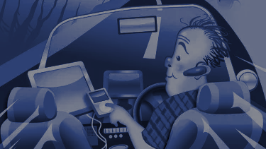
SOFTWARE ENGINEERING PROJECT
Distracted Driver Detection System
Notes:
Good Afternoon Maam,
We atr here to present a ppt on Distracted driver detection system.

Slide 2
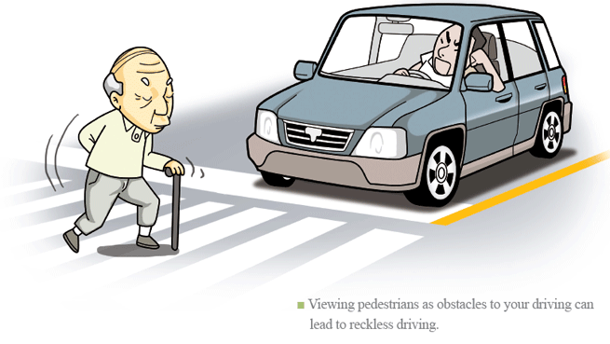
Driving a car is a complex task, and it requires complete attention. Distracted driving is any activity that takes away the driver’s attention from the road. Several studies have identified three main types of distraction: visual distractions (driver’s eyes off the road), manual distractions (driver’s hands off the wheel) and cognitive distractions (driver’s mind off the driving task).
This project aims to recognize unsafe behaviour and send real time feedback to the driver using short sound alert etc.The system can be used to classify the behaviour of a driver via live video feed.
Notes:
Driving a car is a complex task, and it requires complete attention. Distracted driving is any activity that takes away the driver’s attention from the road. .According to the most recent published World Health Organization (WHO) report, it was estimated that, in 2013, 1.25 million people were killed on the roads worldwide, making road traffic injuries a leading cause of death globally [1]Many states now have laws against texting, talking on a cell phone, and other distractions while driving. We believe that computer vision can augment the efforts of the governments to prevent accidents caused by distracted driving (as shown in figure). Our algorithm automatically detects the distracted activity of the drivers and alerts them. We envision this type of product being embedded in cars to prevent accidents due to distracted driving.This project aims to recognize unsafe behaviour and send real time feedback to the driver using short sound alert etc.The system can be used to classify the behaviour of a driver via live video feed.

Slide 3
Problem Description:
Distracted Driving, a term which is coined for doing any kind of activity that can divert your attention away from the task of safe driving, including talking or texting on your phone, eating and drinking, talking to people in your vehicle, fiddling with the stereo, entertainment or navigation system. In this report, a module for Advanced Driver Assistance System (ADAS) is presented to reduce the number of accidents due to drivers' distractions and fatigue and hence increase the transportation safety. This system deals with automatic driver drowsiness detection based on visual information and Artificial Intelligence.
Notes:
Basically The aim is to detect the obstacle or identify the cause by which driver gets distracted and alert the driver.Here We need to proposed an algorithm that automatically detects the distracted activity of the drivers and alerts them or to recognize unsafe behaviour and send real time feedback to the driver using short sound alert and by displaying message etc.

Slide 4
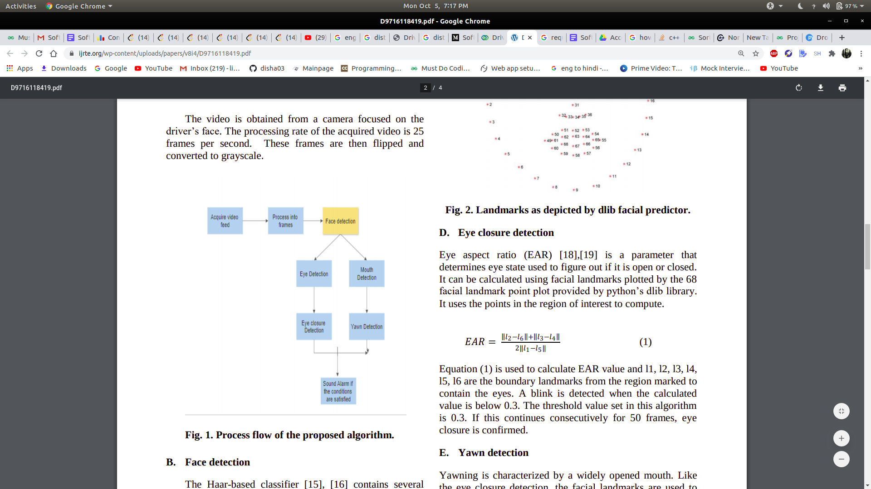
Process flow of the proposed algorithm.
Proposed Solution
To overcome the problem, came up with the solution implemented using OpenCV, DLib and other open source libraries . Python is used as a language to implement the idea.
A web camera is used to continuously track the facial landmark and movement of eyes and lips of the driver. This project mainly targets the landmarks of lips and eyes of the driver. For detection of drowsiness, landmarks of eyes are tracked continuously. If the driver is found to be distracted then a voice (audio) alert is provided and a message is displayed on the screen.
Notes:
Now if I want to talk about Process flow of the proposed algorithm -
To overcome the problem, came up with the solution implemented using OpenCV, DLib and other open source libraries . Python is used as a language to implement the idea.The video is obtained from a camera focused on the driver’s face. The processing rate of the acquired video is 30 frames per second. These frames are then flipped and converted to grayscale. Then it detects face , if face is detected then it detects mouth and eyes of the driver, if everthing go well and any ditracted activity is distracted then sound or alart is produced

Slide 5
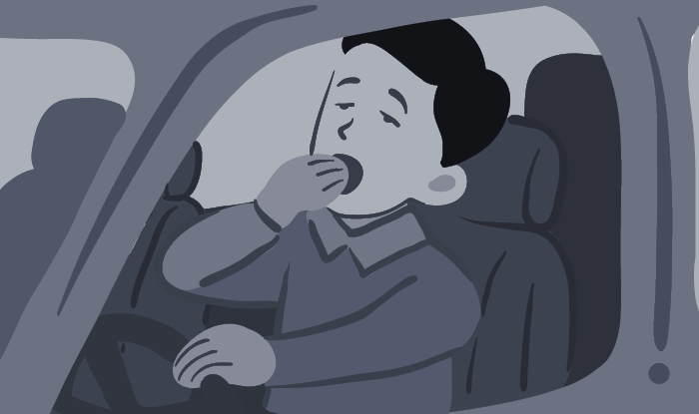
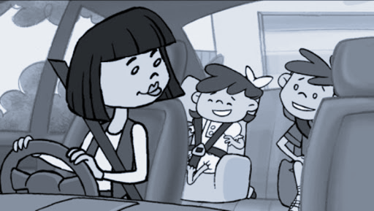
Following use cases are covered in this project :
1. If the eyes of drivers are closed for a threshold period of time then it is considered that the driver is feeling sleepy and a corresponding audio alarm is used to make the driver aware.
2. If the mouth of the driver remains open for a certain period of time then it is considered that the driver is yawning and corresponding suggestions are provided to the driver to overcome drowsiness.
Driver is feeling sleepy (Yawning)
3. If the driver doesn't keep eyes on the road then it is observed using facial landmarks and the corresponding alarm is used to make the driver aware.
Driver gets distracted

Slide 6
Requirement Specification:
The code of this system has been written in python mainly. For the smooth functioning of this system, some libraries and software must be there in the user Operating system priorly.
SOFTWARE REQUIREMENTS
Operating system - Windows is used as the operating system as it is stable and supports more features and is more user friendly
Dependencies
Python 3
opencv (tested with 3.4)
dlib (tested with 19.18.0)
imutils (tested with 0.5.3)
scipy
numpy
Argparse
Espeak (compact open source software)
g
Notes:
The code of this system has written in python mainly. For the smooth functioning of this system, some libraries like Opencv,scipy,imutils ,dlibs and software like espeak must be there in the user Operating system priorly.
To Run this function we need to type the command on terminal or any shell or software which we are using:
Python3 drowsiness_yawn.py (we save it as drowsiness_yawn.py) -- webcam
//For external webcam, use the webcam number accordingly

Slide 7
HARDWARE REQUIREMENTS :
Intel core i5 2nd generation is used as a processor because it is faster than other processors and provides reliability and stability and we can run our pc for a long time.By using this processor we can keep on developing our project without any worries.Ram 1 gb is used as it will provide fast reading and writing capabilities and will in turn support in processing
Run :
Python3 drowsiness_yawn.py -- webcam
//For external webcam, use the webcam number accordingly
Setups :
Change the threshold values according to your need
EYE_AR_THRESH = 0.3
EYE_AR_CONSEC_FRAMES = 30
YAWN_THRESH = 10` //change this according to the distance from the camera
Notes:
To Run this function we need to type the command on terminal or any shell or software which we are using:
Python3 drowsiness_yawn.py (we save it as drowsiness_yawn.py) -- webcam

Slide 8
Feasibility Study
Feasibility analysis is used to determine the viability of an idea, such as ensuring a project is legally and technically feasible as well as economically justifiable.
This technology provides a new platform to detect operator drowsiness and has the potential to reduce distraction-related crashes in driving and aviation. The proposed distracted detector system developed and expected to reduce the road accident from doing any activity that takes your attention from driving. Focusing on truck transportation providers -risk groups for distraction.

Slide 9
Software Process Model Followed for the development
In the implementation and development of our system, we are following both a plan-driven and incremental or iterative approach (mix of both the approaches).
The model preparation section is decomposed into many small parts that can be incrementally developed and each incremental part is developed over an iteration. At a time one iteration is planned, developed and deployed to the customers.

Slide 10
Benefits of using this kind of Model Approach-
Improved system usability.
A closer match to users’ real needs.
Improved design quality.
Improved maintainability.
Reduced development effort.

Slide 11
Detailed Description of the methods followed for different components of the model
This section provides an overview of the approach that we have used to prepare the model that will be used later to decide if the driver is distracted.The proposed method will group frames in videos, based on special facial features obtained through Haar Cascade and Dlib
Stage 1-
Outline Description- This project aims to recognize unsafe behaviour and send real time feedback to the driver using short sound alert etc.The system can be used to classify the behaviour of a driver via live video feed.
The rest of things like motivation and scope of this project is included above in this report.

Slide 12
Scipy-
SciPy stands for Scientific Python. SciPy is a scientific computation library that uses NumPy underneath. It provides more utility functions for optimization, stats and signal processing.
Imutils-
Series of convenience functions to make basic image processing functions such as translation, rotation, resizing, skeletonization, and displaying Matplotlib images easier with OpenCV and Python.
OpenCV
Open Source Computer Vision Library is an open source computer vision and machine learning software library. OpenCV was built to provide a common infrastructure for computer vision applications and to accelerate the use of machine perception in the commercial products.
Using OpenCV, we can read an image, display it and after we are done with our operations for the day, save it.
Notes:
Now we draw bounding box and text prediction with cv2.rectangle() and cv2.putText() on our frame.
cv2.imshow-Now we are displaying frame on the screen and at the end of code stopping the stream and closing stream window:

Slide 13
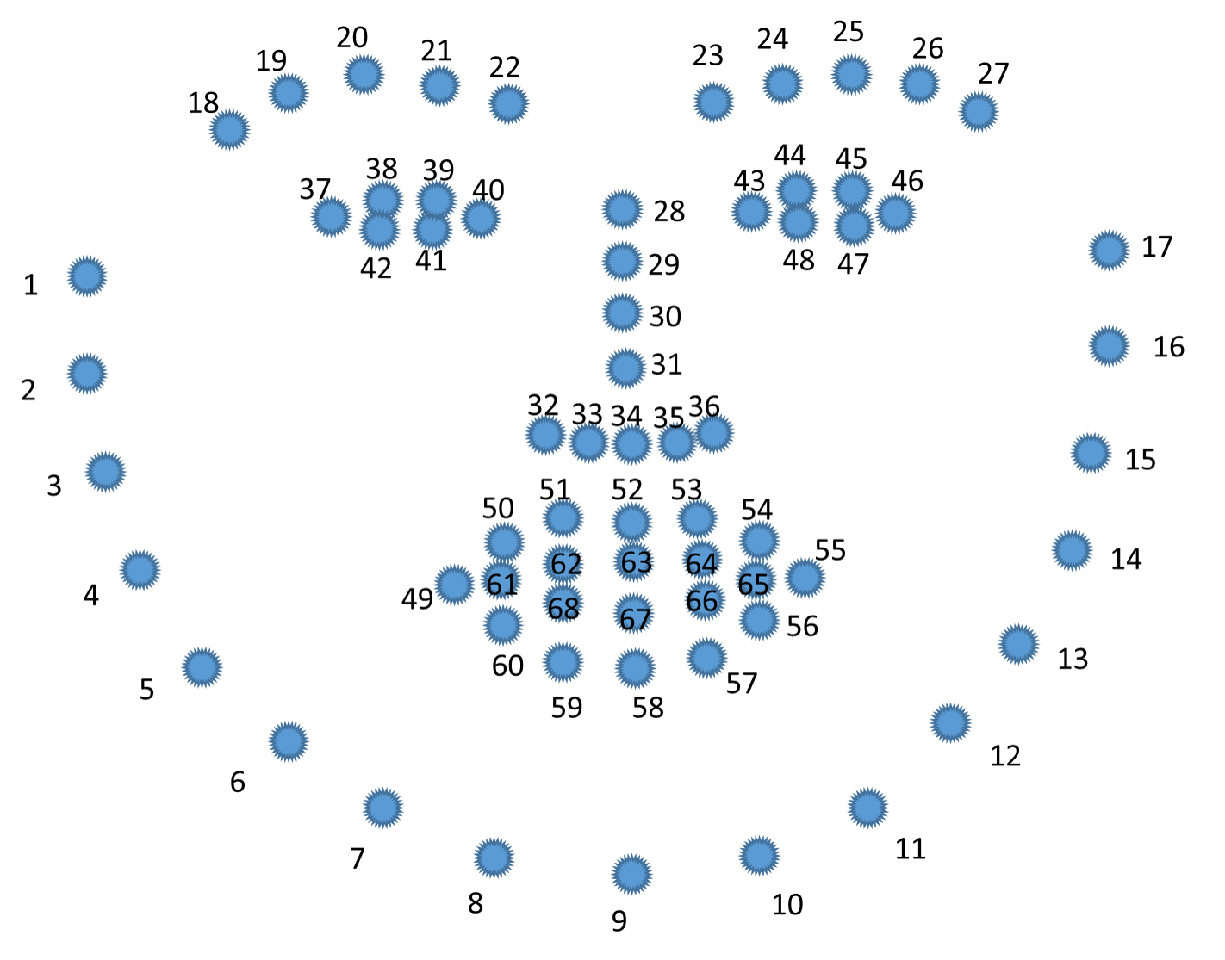
Facial Landmarks-
Facial landmarks are used for localizing and representing salient regions or facial parts of the person’s face, such as:
Facial Landmarks Detection has 2 steps:
It involves localizing the face in the image.
To detect the key facial structures on the person’s face.
DLIB-
The facial landmark detector which is pre-trained inside the dlib library of python for detecting landmarks, is used to estimate the location of 68 points or (x, y) coordinates which map to the facial structures. These indexes of 68 coordinates or points can be easily visualized on the image below:

Slide 14
Examining the image, we can see that facial regions can be accessed via simple Python indexing
The mouth can be accessed through points [48, 68].
The right eyebrow through points [17, 22].
The left eyebrow through points [22, 27].
The right eye using [36, 42].
The left eye with [42, 48].
The nose using [27, 35].
And the jaw via [0, 17].
These mappings are encoded inside the FACIAL_LANDMARKS_IDXS dictionary inside face_utils of the imutils library.

Slide 15
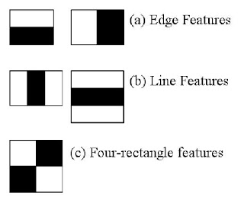
Haar Cascade
Object and Face Detection using Haar feature-based cascade classifiers is an effective object detection method proposed by Paul Viola and Michael Jones in their paper, “Rapid Object Detection using a Boosted Cascade of Simple Features” in 2001.
It is a machine learning based approach where a cascade function is trained from a lot of positive and negative images.
The algorithm has four stages:
Haar Feature Selection
Creating Integral Images
Adaboost Training
Cascading Classifiers

Slide 16
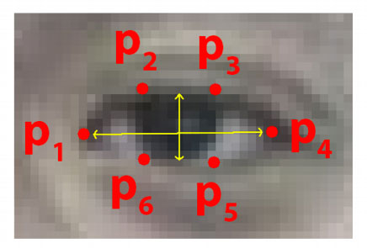
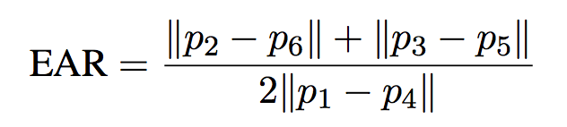
def eye_aspect_ratio(eye):
A = dist.euclidean(eye[1], eye[5])
B = dist.euclidean(eye[2], eye[4])
C = dist.euclidean(eye[0], eye[3])
ear = (A + B) / (2.0 * C)
return ear
def final_ear(shape):
(lStart, lEnd) = face_utils.FACIAL_LANDMARKS_IDXS["left_eye"]
(rStart, rEnd) = face_utils.FACIAL_LANDMARKS_IDXS["right_eye"]
leftEye = shape[lStart:lEnd]
rightEye = shape[rStart:rEnd]
leftEAR = eye_aspect_ratio(leftEye)
rightEAR = eye_aspect_ratio(rightEye)
ear = (leftEAR + rightEAR) / 2.0
return (ear, leftEye, rightEye)
Eye Closure Calculation-
Each eye is represented by 6 (x, y)-coordinates, starting at the left-corner of the eye (as if you were looking at the person), and then working clockwise around the eye:
Eye Aspect Ratio-

Slide 17
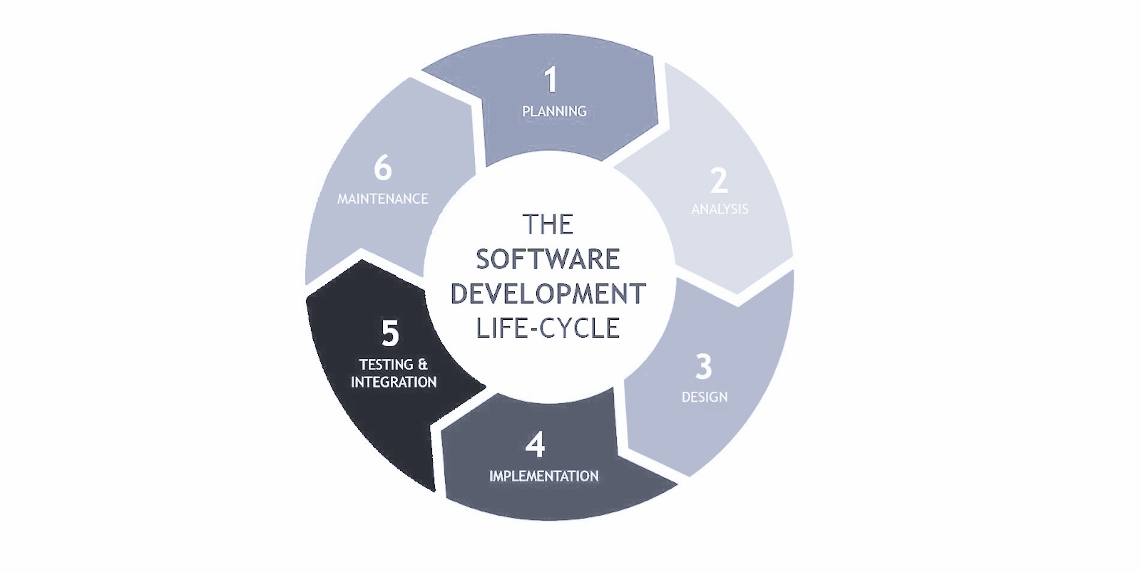
Complete Software Development Life-cycle Followed for the Development
Stage 1: Planning :
We were planning to recognize unsafe behaviour and send real time feedback to the driver using short sound alert etc.
Stage 2: Requirement Analysis:-
The code of this system has been written in python mainly. For the smooth functioning of this system, some libraries and software must be there in the user Operating system priorly.
Stage 3: Design:-
We use OpenCV library for the software GUI. Open Source Computer Vision Library is an open source computer vision and machine learning software library. OpenCV was built to provide a common infrastructure for computer vision applications and to accelerate the use of machine perception in the commercial products.

Slide 18
Stage 4:- Implementation or Coding:-
Step1: Firstly The video is obtained from a camera focused on the driver’s face. The processing rate of the acquired video is 30 frames per second.
Step 2: These frames are then flipped and converted to grayscale.
Step 3: Then it detects face , if face is detected then it detects mouth and eyes of the driver,
Step 4: If everything go well and any distracted activity is distracted then sound or alert is produced
Stage 5: Testing:-
We have tested the software on different types of distraction and different different situations and it gives accurate results in 90% of cases.
Stage 6: Maintenance:-
We need to update the libraries which are used in this system in a definite interval of time.For the smooth functioning of this system, some libraries and software must be always there in the user Operating system with their proper version .

Slide 19
Results and Conclusion:
When the subject is detected to have closed eyes or using phone while driving the message “Distracted ALERT” along with an alarm being activated. Fig. 2. depicts a subject yawning. The detection is acknowledged by messages “Yawn ALERT” and Yawn count value.
Distracted driving is a major problem leading to a striking number of accidents worldwide. Its detection is an important system component in semi autonomous cars. The proposed algorithm is expected to detect drowsiness in a driver using eye closure and yawning as markers. At last The system will be tested on a variety of subjects with a limited number of test cases.
Notes:
The subject is placed in front of the camera so that the face is in focus. The window displays the plotted landmarks, yawn count and a message of the subject’s state. It is expected that An alarm will be sounded when the yawn count exceeds the set boundary parameter. Alarm is also sounded if the eyes are found to be closed. When the subject found distracted then message along with an alarm being activated.

Slide 20
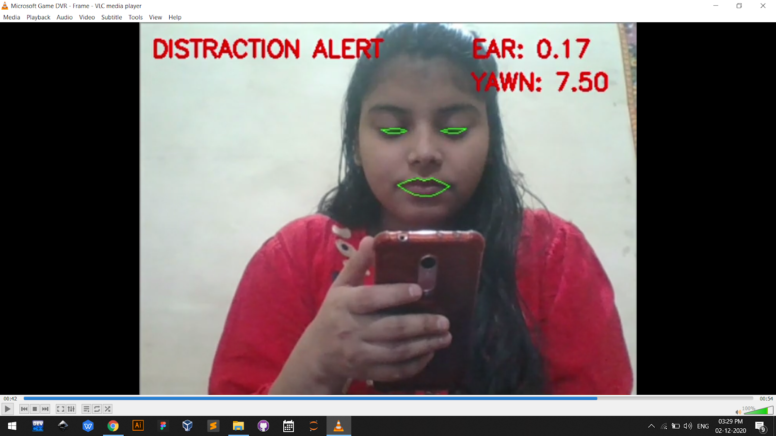
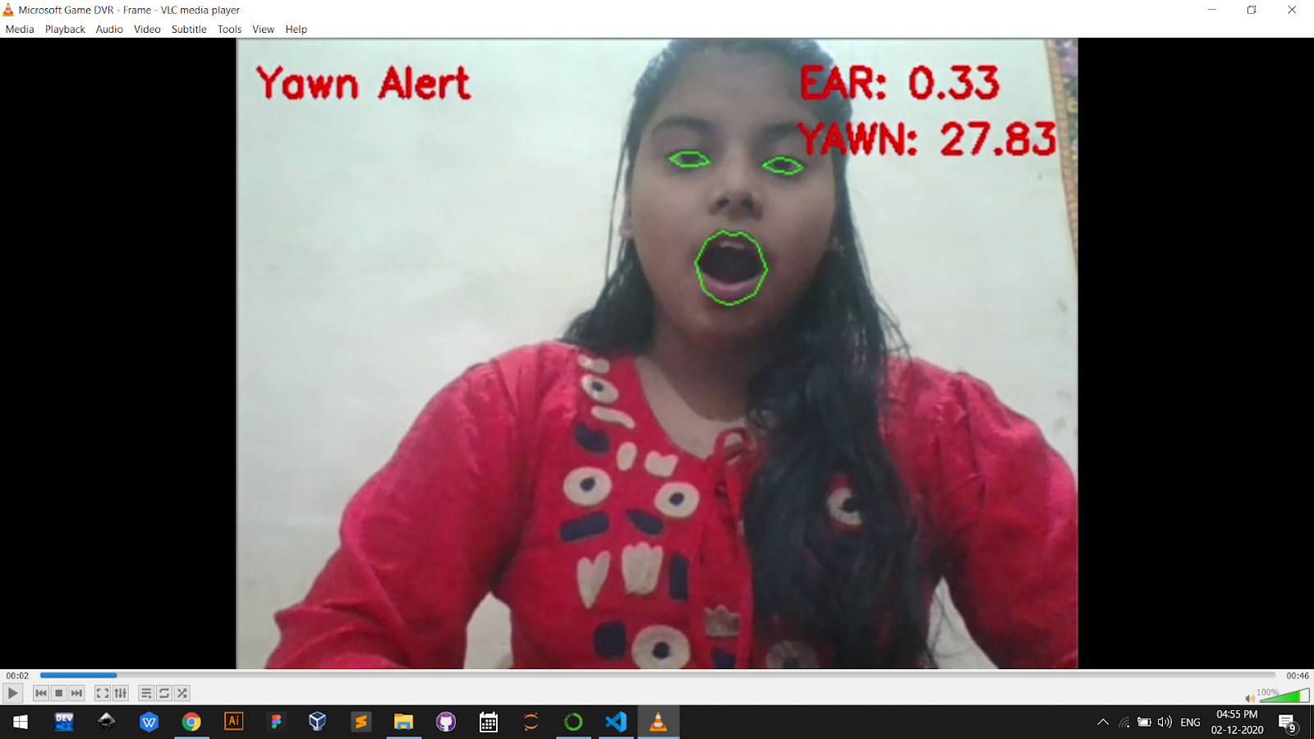
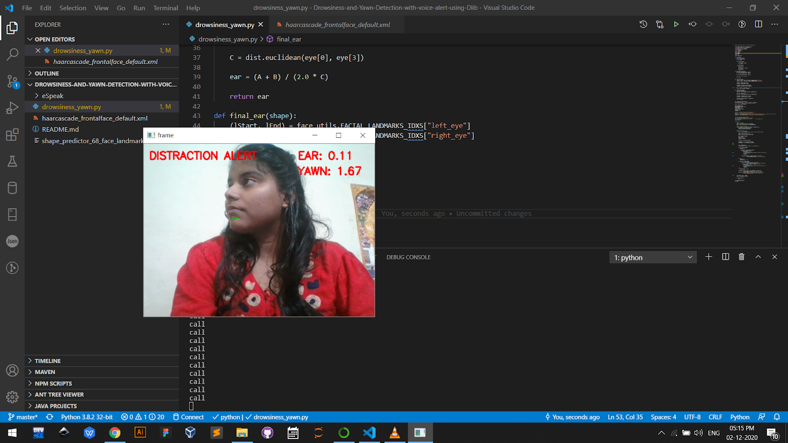
These pictures show the result of the software
These pictures show the result of the software:

Slide 21
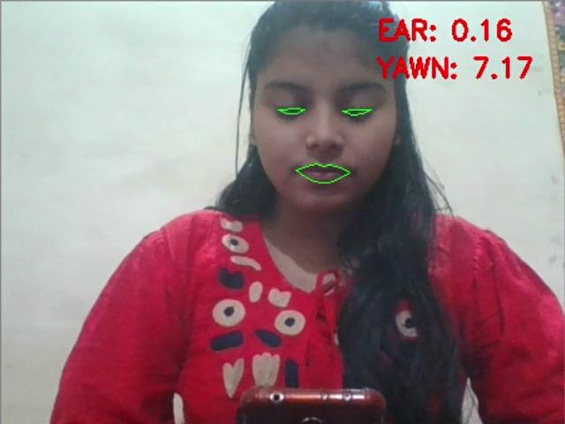

Slide 22
Team Members
GROUP VII
Disha Gupta (LIT2018026)
Saakshi Jain (LIT2018075)
Submitted To:-
Dr. Vishal Krishna Singh

Slide 23
THANKS!

